Slide 1
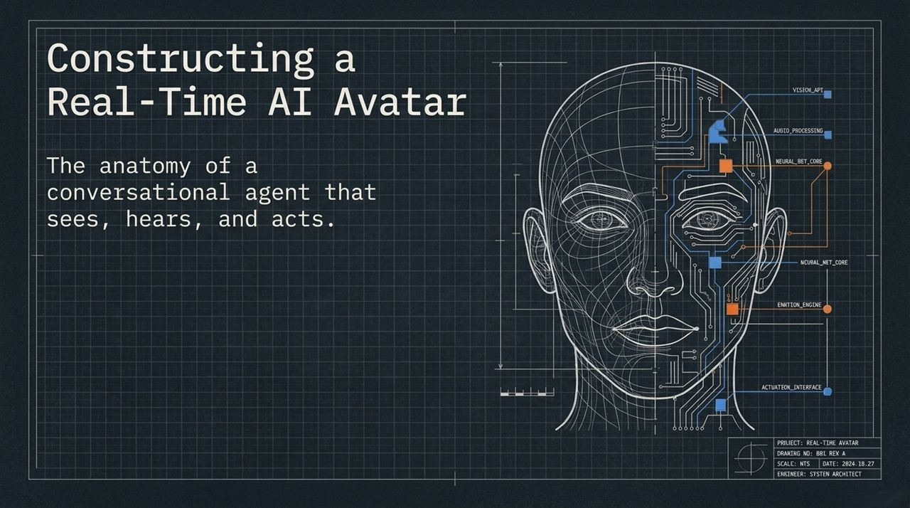
Notes:
Good morning, everyone, and welcome. Today, we’re going to dive into the architecture and engineering required to build a full-duplex, real-time conversational AI avatar—one that doesn't just listen and talk back, but actively sees through a camera, executes real-world backend actions, and queries grounded knowledge bases in real time.
If you look at the system architecture schematic on this slide, you’ll see the primary components of what we call a 'conversational agent that sees, hears, and acts':
Vision API / Interface: For processing live video frames directly from the user's camera feed.
Audio Processing Core: Handling real-time speech-to-text (STT) transcription and streaming text-to-speech (TTS) synthesis.
Neural Net / Emotion Engine: Managing language generation, sentiment tracking, and controlling the visual avatar's facial actuation and lip-syncing in real time.
Actuation & Backend Gateway: Interfacing directly with HTTP endpoints and local application databases to execute side effects.
Traditionally, building a system like this meant stitching together four or five separate APIs—a speech model, a large language model, a vision pipeline, and a visual rendering engine—causing high latency, broken lip-sync, and state synchronization headaches. Today, we'll demonstrate how to unify these components using a modern agentic framework (Aapulu Labs).
https://www.youtube.com/watch?v=CyMIar4TDhw

Slide 2
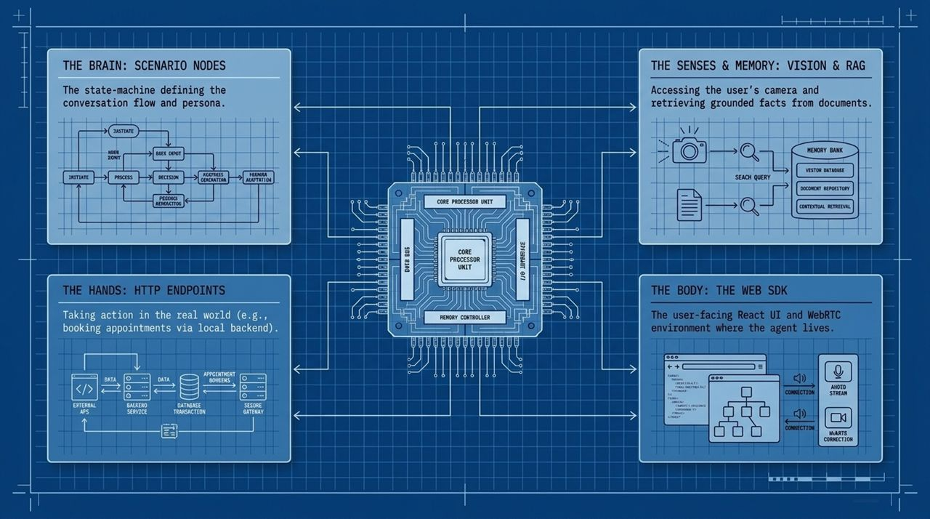
Notes:
To understand how our avatar operates during a live interaction, let's break down its architectural subsystems into four core metaphors:
The Brain (Scenario Nodes & State Machines): Instead of handing a large model a single wall of prompt instructions, we structure the conversation into a deterministic finite state machine (FSM). Each node represents a distinct phase—such as greeting, intake, or scheduling. The brain determines what task the AI performs at any given second.
The Hands (HTTP Endpoints & Tool Interfacing): An agent that can only talk is just a chatbot. 'The Hands' allow the agent to reach into the real world. Through HTTP endpoints, the AI makes authenticated POST requests to backend servers (like local Flask or Node services) to query database availability or confirm bookings.
The Senses & Memory (Vision & RAG): The agent accesses visual data via camera frame grabs and uses Retrieval-Augmented Generation (RAG) to retrieve grounded facts from external files (e.g., Markdown or PDF manuals), preventing hallucinations.
The Body (The Web SDK & UI Container): This is where the user interacts with the system. Built on React and WebRTC, the Web SDK handles low-latency media delivery, browser mic/camera permissions, and real-time state synchronization.

Slide 3
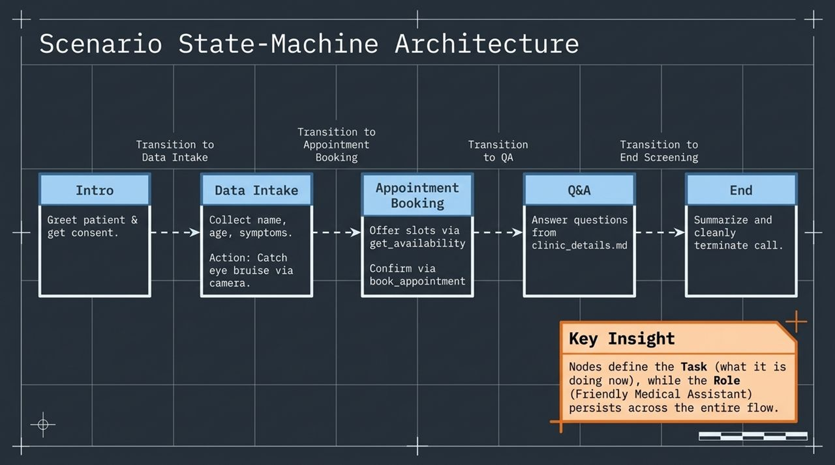
Notes:
Let's trace a concrete end-to-end medical screening flow across its 5 finite conversation nodes:
Node 1: Intro: The avatar introduces itself as a medical assistant, explains the screening process, and requests user consent.
Node 2: Data Intake: Once consent is given, the avatar transitions to gathering basic details (Name, Age, Primary Reason for Visit). If the user holds something up to the screen (e.g., a bruise under the eye), the agent triggers its Vision Tool to analyze the video frame.
Node 3: Appointment Booking: The agent transitions to scheduling. It requests preferred dates, calls a backend tool (get_availability) to fetch open slots, and confirms the choice via book_appointment.
Node 4: Q&A: The user asks general clinic questions. The agent routes these queries to a RAG document repository (clinic_details.md).
Node 5: End Screening: The agent summarizes the session, outlines next steps, and cleanly terminates the WebRTC session.
Key Architectural Insight: Nodes define the specific Task (what the AI is doing now), while the persistent Role (Friendly Medical Assistant) remains anchored across the entire conversation flow.

Slide 4
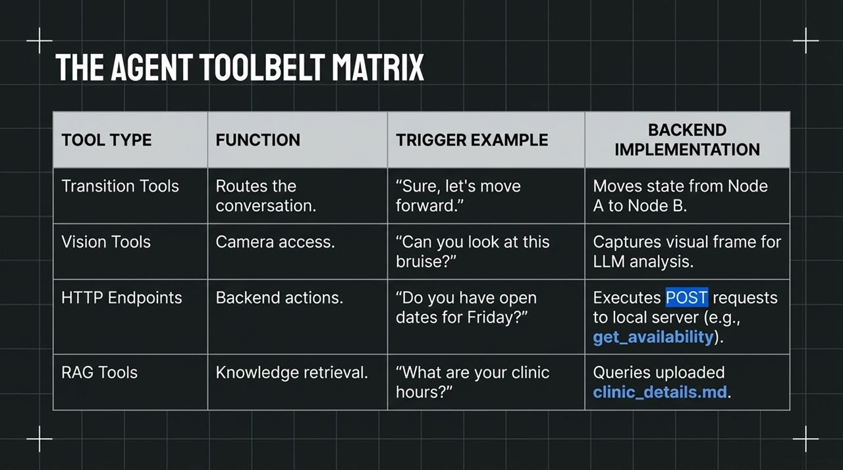
Notes:
To make node transitions and real-world interactions execution-safe, we categorize tool functions into a structured matrix:
Transition Tools: Handled internally by the state machine. Triggered by user intent (e.g., 'Let's move forward') to move the active focus from Node A to Node B.
Vision Tools: Enables on-demand multi-modal analysis. Triggered when a user says, 'Can you look at this bruise?' It captures a frame from the user's video stream and feeds it into the LLM vision decoder.
HTTP Endpoints: External API hooks. Used for backend transactions, such as executing a POST request to check open calendar slots.
RAG Tools: Vector or document search functions. Triggered by domain-specific user queries ('What are your clinic hours?'), searching files like clinic_details.md.

Slide 5
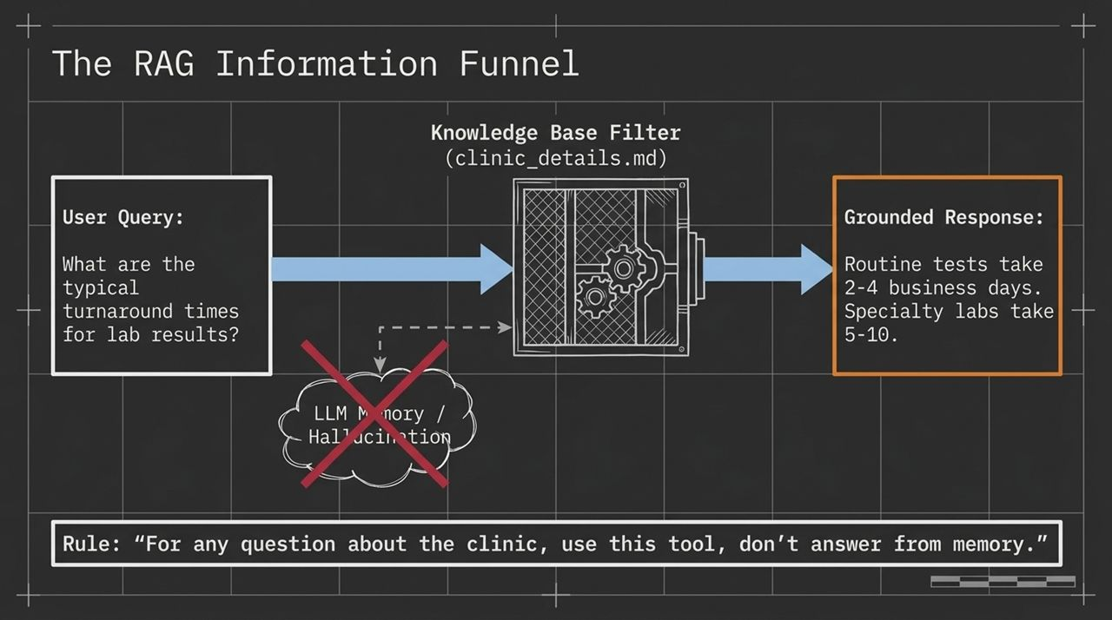
Notes:
Hallucinations in domain-specific conversational AI (especially healthcare or finance) are unacceptable. To guarantee accuracy, we deploy a strict RAG Information Funnel.
When a user asks a factual question (e.g., 'What are the typical turnaround times for lab results?'), the system routes the query away from general parametric LLM memory. Instead, it passes through a Knowledge Base Filter containing uploaded source documentation (clinic_details.md).
The System Prompt Rule:
'For any question about the clinic, use this tool; don't answer from memory.’
This simple prompt enforcement forces the model to fetch grounded information—returning precise facts (e.g., 'Routine tests take 2-4 business days')—and prevents speculative, ungrounded responses.

Slide 6
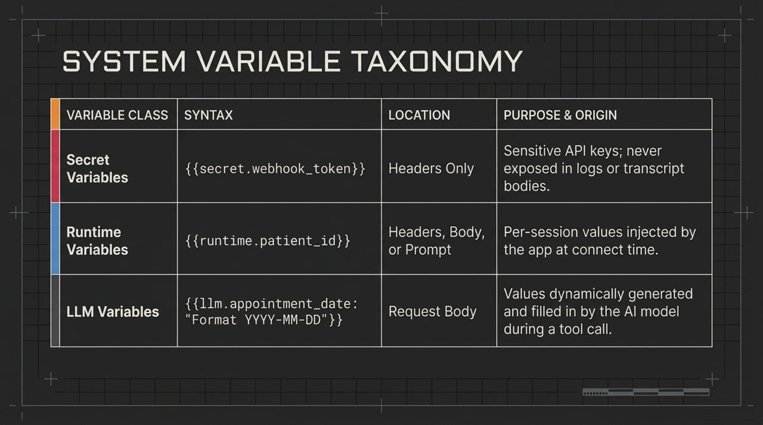
Notes:
When configuring agent tools and headers, we distinguish between three distinct classes of variables:
1. Secret Variables ({{secret.webhook_token}}):
Location: Headers Only.
Purpose: Sensitive API keys or webhook tokens. Because request bodies are often logged in call transcripts or client-side logs, secret variables must never be placed in the body or prompt.
2. Runtime Variables ({{runtime.patient_id}}):
Location: Headers, Body, or Prompts.
Purpose: Per-session contextual data injected by the parent web application at session connection time (e.g., logged-in User ID or today's date).
3. LLM Variables ({{llm.appointment_date: Format YYYY-MM-DD}}):
Location: Request Body.
Purpose: Dynamic parameters generated and extracted by the LLM during live dialogue (e.g., parsing 'Next Friday at 1:30' into 2026-06-26).

Slide 7
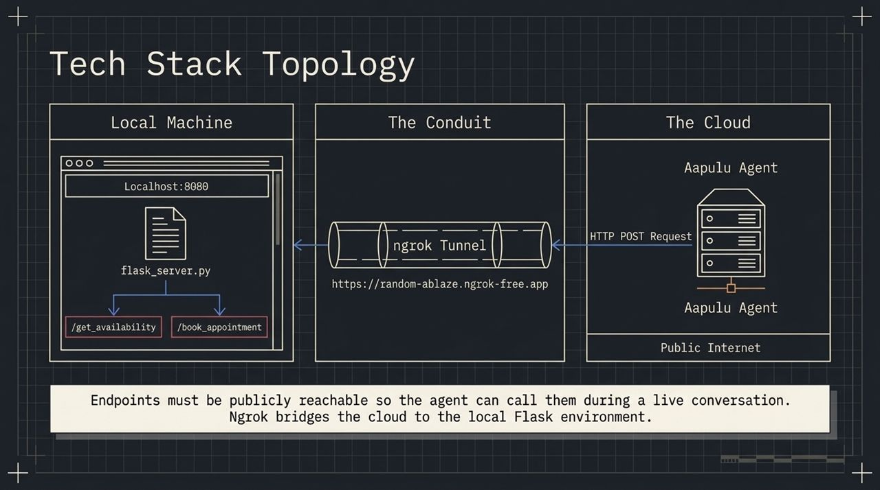
Notes:
During development or hybrid edge-cloud deployments, your avatar engine runs in the cloud, while your business logic and backend services may run on localhost or private subnets.
The Cloud Layer: The avatar platform executes prompt logic, lip-sync rendering, and speech processing.
The Conduit: When the agent needs to call an HTTP tool (e.g., /get_availability), it issues an HTTP POST over the public internet.
Ngrok Tunneling: To route this request back to a local Flask server running on localhost:8080, we establish a secure ngrok tunnel (https://<hash>.ngrok-free.app).
Local Processing: Flask receives the request, processes the local database transaction, and returns the JSON payload back through the conduit to the cloud agent.

Slide 8
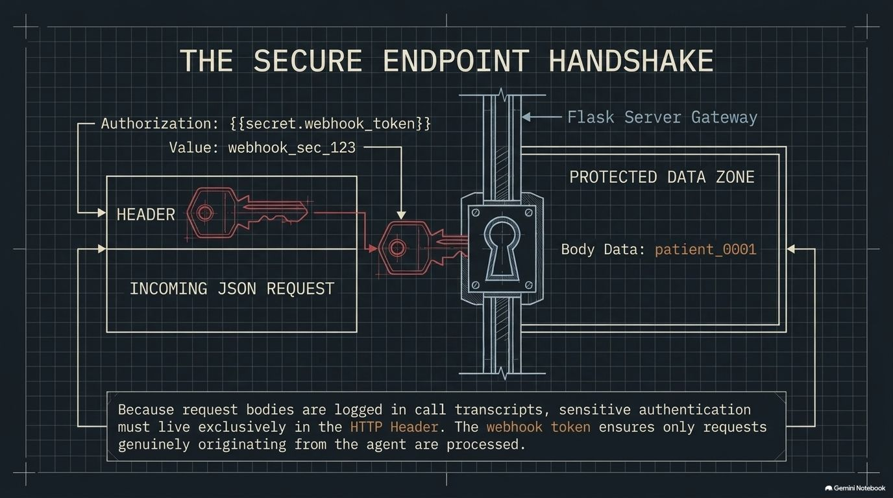
Notes:
Security must be built into real-time voice architectures from day one. Slide 8 details how incoming HTTP requests from the avatar agent are verified at your API gateway.
When the AI agent triggers an HTTP endpoint, it attaches an Authorization header populated with your secret variable ({{secret.webhook_token}}).
Header Validation: The backend Flask/Node gateway inspects the incoming request header for webhook_sec_123.
Body Isolation: Contextual data like patient_id sits inside the JSON payload body in the protected zone.
Audit Safety: Because raw request bodies are saved into conversation logs and debug transcripts, isolating authentication keys in the HTTP Header guarantees that API credentials never leak into transcripts or database logs.

Slide 9
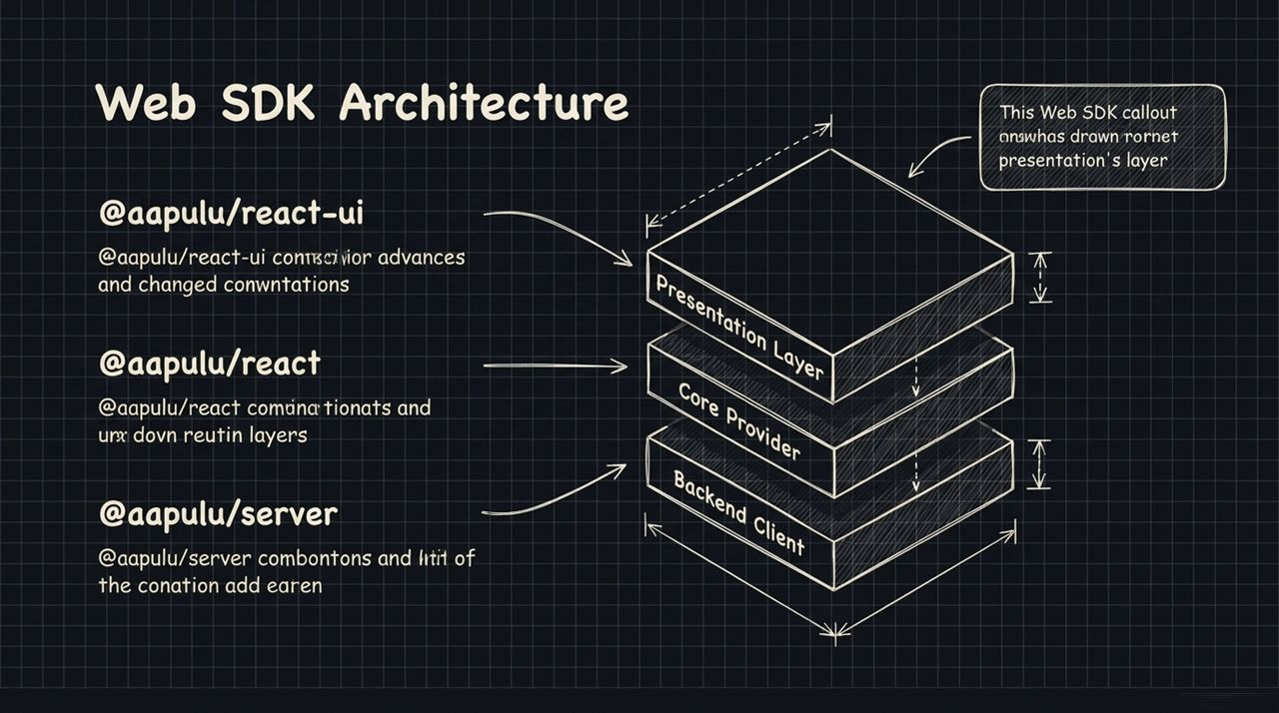
Notes:
Client-side integration is modularized across three NPM packages within the @aapulu ecosystem:
@aapulu/server (Backend Client): Runs on your secure backend (Node/Next.js API routes). It uses your primary API key to authenticate session connection requests without exposing API keys to the client browser.
@aapulu/react (Core Provider & Hooks): Provides state management hooks, manages media devices (microphone/camera), and handles incoming WebRTC event listeners.
@aapulu/react-ui (Presentation Layer): Pre-built, customizable UI components (e.g., <AapuluConversation/>). This component automatically renders video containers, live transcript overlays, and mute/camera controls with slot-level CSS styling.

Slide 10
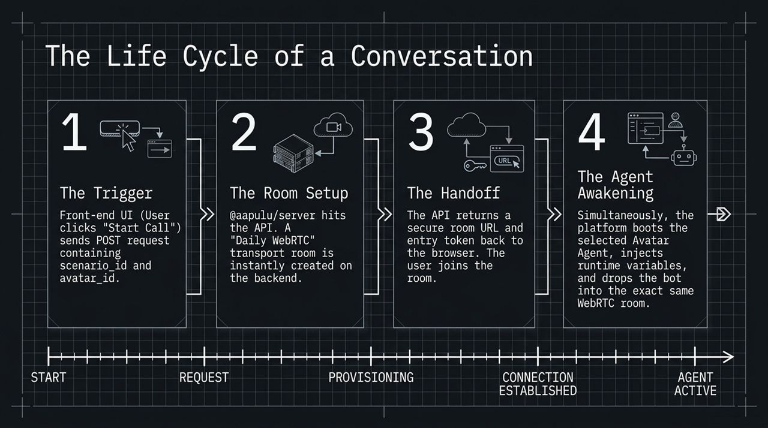
Notes:
Let's walk through the 4-stage technical lifecycle that occurs when a user initiates a call:
Step 1: The Trigger: The user clicks 'Start Call' on the front-end UI. The frontend issues a POST request containing the scenario_id and selected avatar_id to the local backend route (/api/connect).
Step 2: Room Setup: The backend server calls the platform API. A low-latency WebRTC transport room (powered by Daily infrastructure) is provisioned on the fly.
Step 3: The Handoff: The platform returns a secure WebRTC room URL and access token back to the browser, allowing the user's client to enter the room.
Step 4: The Agent Awakening: Simultaneously, the platform spins up the specified Avatar Agent instance, injects runtime variables, and connects the bot as a second participant into the WebRTC room.

Slide 11
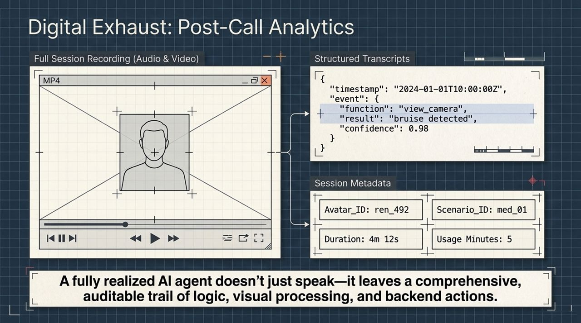
Notes:
Every completed avatar session produces a comprehensive set of diagnostic and compliance records, which we refer to as 'Digital Exhaust':
Full Session Recording: High-definition MP4 video/audio files capturing both user and avatar media streams for quality assurance and training.
Structured Transcripts: Timed JSON logs detailing exact user speech, agent audio responses, tool executions (e.g., view_camera returning bruise detected with a confidence score of 0.98), and node transition events.
Session Metadata: Tracked attributes including Avatar_ID, Scenario_ID, call duration, and billable compute usage.
This audit trail ensures enterprise traceability across automated decisions and backend actions.
Slide 12: End-to-End System Architecture Blueprint

Slide 12
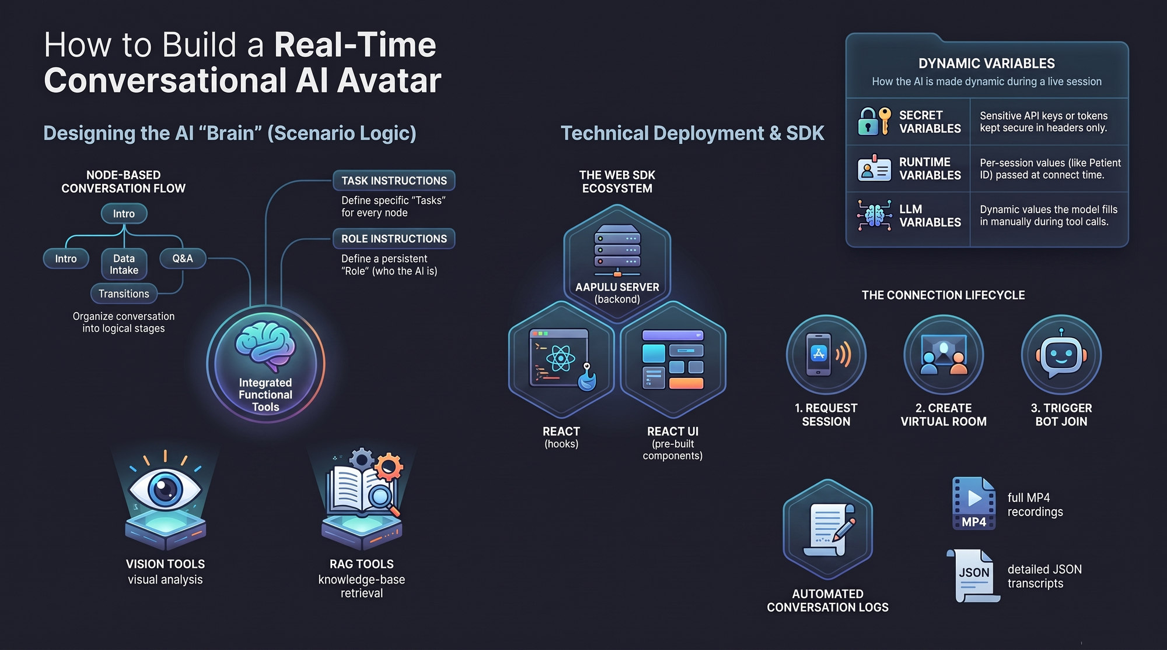
Notes:
To wrap up our architecture overview, Slide 12 synthesizes all the components into a single system design map:
The AI Brain: Defined by Node-Based Conversation Flows with clear separations between node-level Task Instructions and global Role Instructions.
Functional Integration: Embedded tools spanning Vision analysis, RAG retrieval, and secure HTTP endpoints.
Dynamic Scoping: Controlled variable resolution split across Secrets, Session Runtimes, and LLM extraction.
SDK Layer: Clean abstraction between server authentication (@aapulu/server), state management (@aapulu/react), and UI elements (@aapulu/react-ui).
Automated Telemetry: Native capture of MP4 recordings and JSON transcript payloads.
With this blueprint in place, you have a complete blueprint for deploying production-grade, real-time avatar agents. Thank you!
https://www.youtube.com/watch?v=CyMIar4TDhw

